Slide 1

Revolutionising B.Tech

Slide 2
MODULE - 3
Classes and Exceptions

Slide 3
Classes and Exceptions
.
MODULE 3: Classes and Exceptions [12 hours]
Difference between OOP and POP programming, Classes: Grouping data, Class methods, Class and instance object types, Class constructors, Class interfaces, Class customization, Classes as numeric types, Memory allocation and garbage collection, Decorators, Generators, Handling exceptions using try and except, Multiple exception handlers, raising exceptions, Exceptions with functions, using finally to clean up, Custom exception types.

Slide 4
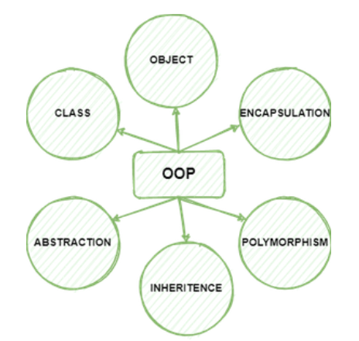
Object-Oriented Programming
.
Main Concepts of Object-Oriented Programming (OOPs)
Class
Objects
Polymorphism
Encapsulation
Inheritance
Data Abstraction

Slide 5
OOP Vs POP
Differences between OOP and POP.
Sr. No. | Key | OOP | POP
1 | Definition | OOP stands for Object Oriented Programing. | POP stands for Procedural Oriented Programming.
2 | Approach | OOP follows bottom up approach. | POP follows top down approach.
3 | Division | A program is divided to objects and their interactions. | A program is divided into funtions and they interacts.
4 | Inheritance supported | Inheritance is supported. | Inheritance is not supported.
5 | Access control | Access control is supported via access modifiers. | No access modifiers are supported.
6 | Data Hiding | Encapsulation is used to hide data. | No data hiding present. Data is globally accessible.
7 | Example | C++, Java | C, Pascal

Slide 6
Classes and Objects
Introduction
Python is an Object Oriented Programming language.
Classes and Objects are the key features of Object Oriented Programming.
Theoretical concepts of classes and objects are very similar to that of C++.
But, creation and implementation of classes and objects is very simple in Python compared to C++.

Slide 7
Classes and Objects
Python Classes and Objects
A class is a collection of objects, A class is the main building block in Python.
Object is a collection of data and function that act on those data.
Class is a template for the object. According to the concept of Object Oriented Programming, objects are also called as instances of a class or class variable.
In Python, everything is an object. For example, all integer variables that we use in our program is an object of class int.
Similarly all string variables are also object of class string.

Slide 8
Classes and Objects
Defining classes
In Python, a class is defined by using the keyword class. Every class has a unique name followed by a colon ( : ).
Syntax:
class class_name:
statement_1
statement_2
…………..
…………..
statement_n
Example: Program to define a class
class Sample:
x, y = 10, 20 # class variables

Slide 9
Classes and Objects
Defining classes
The statement in a class definition may be a variable declaration, decision control, loop or even a function definition.
Variables defined inside a class are called as “Class Variable” and functions are called as “Methods”.
Class variable and methods are together known as members of the class.
The class members should be accessed through objects or instance of class.
A class can be defined anywhere in a Python program.

Slide 10
Classes and Objects
Example: Program to define a class
class Sample: # Class name
x, y = 10, 20 # class variables
def speak(self): # class method
print(“JAIN”)
In the above code, name of the class is Sample and it has two variables x and y having the initial value 10 and 20 respectively. To access the values defined inside the class, you need an object or instance of the class.

Slide 11
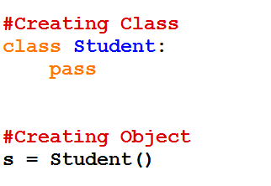

Classes and Objects
Creating Objects
Once a class is created, next you should create an object or instance of that class. The process of creating object is called as “Class Instantiation”.
Syntax:
Object_name = class_name( )
Note that the class instantiation uses function notation.
Many classes like to create objects with instances customized to a specific initial state.

Slide 12
Classes and Objects
Accessing Class Members
Any class member ie. class variable or method (function) can be accessed by using object with a dot ( . ) operator.
Syntax:
Object_name . class_member
Example 1
class MyClass:
x = 5 # Variable Declaration
p1 = MyClass() # Object declaration
print(p1.x)
Output : 5

Slide 13
Classes and Objects
Example : Program to define a class and access its member variables
class Sample:
x, y = 10, 20 #class variables
S=Sample( ) # class instantiation
print("Value of x = ", S.x)
print("Value of y = ", S.y)
print("Value of x and y = ", S.x+S.y)
Output :
Value of x = 10
Value of y = 20
Value of x and y = 30
In class instantiation process, we have created an object S to access the members of the class. The first two print statements simply print the value of class variable x and y and the last print statement add the two values and print the result.

Slide 14
Classes and Objects
Class Methods
Python class function or Method is very similar to ordinary function with a small difference.
The class method must have the first argument named as self.
Example - def method(self [,parameters]): . . .
No need to pass a value for this argument when we call the method.
When you declare class variable within class, methods must be prefixed by the class name and dot operator.
Note
The statements defined inside the class must be properly indented.

Slide 15
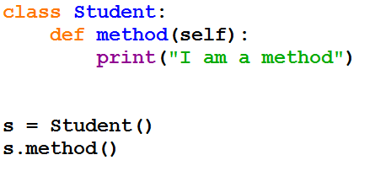
Classes and Objects
Class Methods
Example (passing with argument using function)
class Example:
def __init__(self, a, b): #constructor
self.a = a
self.b = b
def add(self): #function
return self.a + self.b
e = Example(8, 6) #pass arg
print(e.add()) # 14
Adding Methods to Class

Slide 16
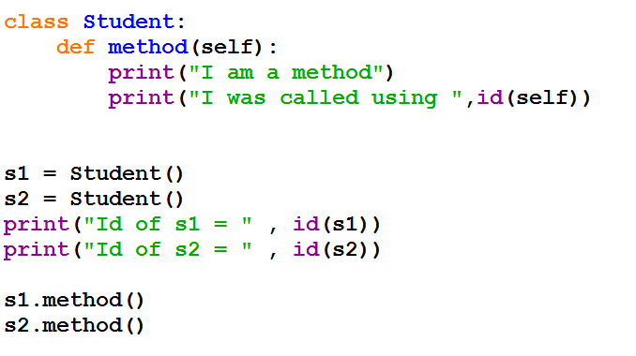
Classes and Objects
Class Methods
Adding Methods to Class

Slide 17
Classes and Objects
Example : program to check and print if the given number is odd or even using class
class Odd_Even:
def check(self, num): # Class Method
if num%2==0:
print(num," is Even number")
else:
print(num," is Odd number")
n=Odd_Even()
x = int(input("Enter a value: "))
n.check(x)
Output
Enter a value: 4
4 is Even number

Slide 18
Classes and Objects
Example: Program to find total and average marks using class
class Student:
mark1, mark2, mark3 = 45, 91, 71 #class variable
def process(self): #class method
sum = Student.mark1 + Student.mark2 + Student.mark3
avg = sum/3
print("Total Marks = ", sum)
print("Average Marks = ", avg)
return
S=Student()
S.process()
Output
Total Marks = 207
Average Marks = 69.0

Slide 19
Classes and Objects
What is a static method?
Static methods in Python are extremely similar to python class level methods, the difference being that a static method is bound to a class rather than the objects for that class.
This means that a static method can be called without an object for that class.
This also means that static methods cannot modify the state of an object as they are not bound to it
Using staticmethod()
Let’s directly jump to sample code snippet on how to use the staticmethod() approach:
class Calculator:
def addNumbers(self, x, y):
return x + y
# create addNumbers static method
Calculator.addNumbers = staticmethod(Calculator.addNumbers)
print('Product:', Calculator.addNumbers(15, 110)) # 125

Slide 20
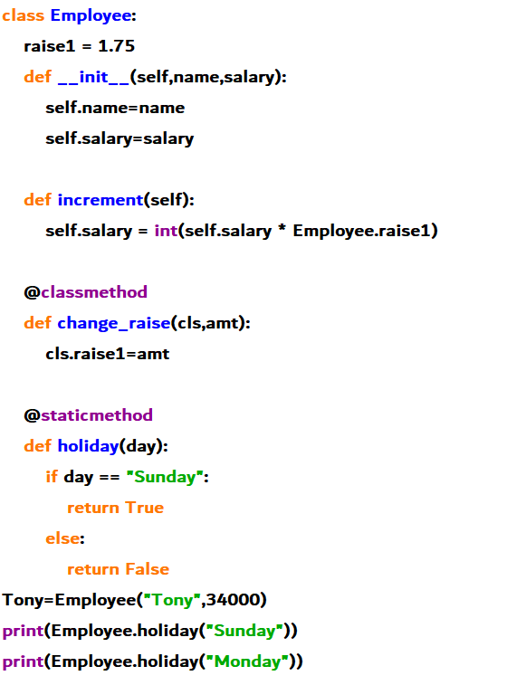
Classes and Objects
static method Vs Class Method?
While a static method requires no specific parameters, a class method takes cls as its first argument.
While a static method cannot access or modify the class state, a class method may.
Static methods are typically unaware of the class state.
class must be a parameter for class methods.
Python's @classmethod decorator and @staticmethod decorator are used to generate class methods and static methods, respectively.

Slide 21
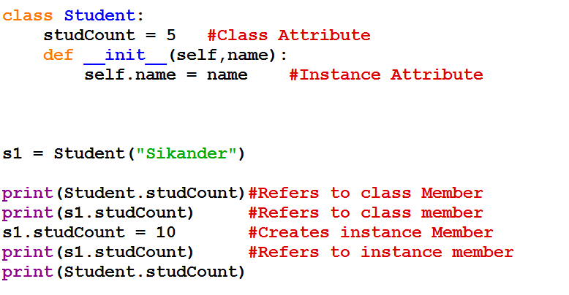
Classes and Objects
Class Attributes
But be careful, if you want to change a class attribute, you have to do it with the notation ClassName.AttributeName. Otherwise, you will create a new instance variable.

Slide 22
Class Constructors
Constructor and Destructor in Python
Constructor is the special function that is automatically executed when an object of a class is created.
In Python, there is a special function called “init” which act as a Constructor.
It must begin and end with double underscore. (__init__)
It is executed automatically when the object is created.
This constructor function can be defined with or without arguments.

Slide 23
Class Constructors
Types of constructors :
default constructor: The default constructor is a simple constructor which doesn’t accept any arguments. Its definition has only one argument which is a reference to the instance being constructed.
parameterized constructor: constructor with parameters is known as parameterized constructor. The parameterized constructor takes its first argument as a reference to the instance being constructed known as self and the rest of the arguments are provided by the programmer.
Syntax of constructor declaration :
def __init__(self):
# body of the constructor

Slide 24
Class Constructors
Example of default constructor :
class jain:
def __init__(self): # default constructor
self.name = “JAIN University"
def print (self): # a method for printing data members
print(self.name)
obj = jain() # creating object of the class
obj.print() # calling the instance method using the object obj
Output
JAIN University

Slide 25
Class Constructors
parameterized constructor
General format of __init__ method (Constructor function)
def __init__(self, [args ……..]):
<statements>
Example : Program to illustrate Constructor
class Sample:
def __init__(self, num1,num):
print("Constructor of class Sample...")
sum=num+num1
print("The value is :", sum)
S=Sample(100,10)
Output
Constructor of class Sample... The value is : 110

Slide 26
Class Constructors
# creating second object of same class
obj2 = Addition(10, 20)
# perform Addition on obj1
obj1.calculate()
# perform Addition on obj2
obj2.calculate()
# display result of obj1
obj1.display()
# display result of obj2
obj2.display()
Example of the parameterized constructor :
class Addition:
first = 0
second = 0
answer = 0
def __init__(self, f, s): # parameterized constructor
self.first = f
self.second = s
def display(self):
print("First number = " + str(self.first))
print("Second number = " + str(self.second))
print(“Sum= " + str(self.answer))
def calculate(self):
self.answer = self.first + self.second
#creating object of the class
# this will invoke parameterized constructor
obj1 = Addition(1000, 2000)
Output
First number = 1000
Second number = 2000
Addition of two numbers = 3000
First number = 10
Second number = 20
Addition of two numbers = 30

Slide 27
Class Constructors
Destructor
Destructor is also a special method gets executed automatically when an object exit from the scope.
It is just opposite to constructor.
In Python, __del__( ) method is used as destructor.

Slide 28
Class Constructors
Destructor - Example : Program to illustrate about the __del__( ) method
class Sample:
num=0
def __init__(self, var):
Sample.num+=1
self.var=var
print("The object value is = ", var)
print("The value of class variable is= ", Sample.num)
def __del__(self):
Sample.num-=1
print("Object with value %d is exit from the scope"%self.var)
S1=Sample(15)
S2=Sample(35)
del S1
del S2
The object value is = 15
The value of class variable is= 1
The object value is = 35
The value of class variable is= 2
Object with value 15 is exit from the scope
Object with value 35 is exit from the scope

Slide 29
Class Constructors
Constructor Vs Method:
Constructor | Method
It is a special type pf method that helps to initialize an object on creation | A method is a set of instructions to perform dome specific task
Has no return type | May or may not have return type
If the programmer does not mention constructor, the default constructor will be called. | There are no default methods
Has the same name as the class name | Can have any name other than keywords
Invoked (called) implicitly | Invoked (called) explicitly
Helps to initialize an object | Helps in exhibiting the functionality of an object

Slide 30
Class Interfaces
What is an Interface?
An interface is a collection of method signatures that should be provided by the implementing class.
An interface contains methods that are abstract in nature. The abstract methods will have the only declaration as there is no implementation.
An interface in python is defined using python class and is a subclass of interface. Interface which is the parent interface for all interfaces.
The implementations will be done by the classes which will inherit the interface. Interfaces in Python are a little different from other languages like Java or C# or C++.
Implementing an interface is a way of writing an organized code.

Slide 31
Class Interfaces
How to declare an interface in Python
Here, we will see how to declare the interface module in Python.
Syntax:
class MyInterface(zope.interface.Interface)
# methods and attributes
Firstly, we will import zope.interface module.
The zope.interface is a module that is used to implement the object interface in python.
The zope.interface library is the way to come out of when something is not clear.
This package export attributes and interfaces directly.
To overcome the uncertainty of the interface zope module is implemented.
Implementation by(class) – This function returns a boolean value. If the class implements the interface it results in True else False.

Slide 32
Class Interfaces
declare an interface in Python - Example
import zope.interface
class MyInterface(zope.interface.Interface):
x = zope.interface.Attribute("foo")
def method1(self, x):
pass
def method2(self):
pass
print(type(MyInterface))
print(MyInterface.__module__)
print(MyInterface.__name__)
# get attribute
x = MyInterface['x']
print(x)
print(type(x))
Output :
<class zope.interface.interface.InterfaceClass>
__main__
MyInterface
<zope.interface.interface.Attribute object at 0x00000270A8C74358>
<class 'zope.interface.interface.Attribute'>

Slide 33
Class Interfaces
Implementing interface
Interface acts as a blueprint for designing classes, so interfaces are implemented using implementer decorator on class.
If a class implements an interface, then the instances of the class provide the interface. Objects can provide interfaces directly, in addition to what their classes implement.
Syntax :
@zope.interface.implementer(*interfaces)
class Class_name:
# methods

Slide 34
Class Interfaces
Implementing interface - Example
import zope.interface
class MyInterface(zope.interface.Interface):
x = zope.interface.Attribute("foo")
def method1(self, x):
pass
def method2(self):
pass
@zope.interface.implementer(MyInterface)
class MyClass:
def method1(self, x):
return x**2
def method2(self):
return "foo"

Slide 35
Class customization
Customize your Python class with Magic or Dunder methods
The magic methods ensure a consistent data model that retains the inherited feature of the built-in class while providing customized class behavior
Let’s go through each of the sections:
Magic Method Syntax
Common Magic Methods
Magic Methods For Binary Operators
Magic Methods For Unary Operators
A Few Other Magic Methods

Slide 36
Class customization
Magic Method Syntax
A method that is wrapped by two underscores on both sides is called Magic Methods(__operator__).
The motive behind the magic method is to overload Python’s built-in methods and its operators.
Example
The __eq__ method takes two arguments – self and the object – to check equality.
What is important to understand is, __eq__ method is invoked when the two objects are compared using the == operator.

Slide 37
Class customization
Common Magic Methods
In Python, we have a diverse range of magic methods – each serves its purpose
Example:
class Square(object):
def __init__(self, number = 2):
self._number = number
def square(self):
return self._number**2
s = Square()
print('Number: % i' % s._number) # 2
print('Square: % i' % s.square()) # 4
we can notice, the default value (2) is used by the __init__ method in the absence of an optional argument. Let’s check some facts about the __init__ method:
The __init__ method provides initial data to the object, not to create an object.
It only returns None; returning other than None raises TypeError.
It customizes the instantiation of a class.

Slide 38
Class customization
Type Conversion
Type Conversion refers to the conversion of one data type to another; Python provides several magic methods to handle the conversion.
__str__ method
__int__, __float__ and __complex__ methods
__bool__ method
__str__ method
The __str__ method requires one positional argument – self – and it returns a string. It is called when an object is passed to the str() constructor
class MyString(object):
def __str__(self):
return 'My String !’
Out=str(MyString())
print(Out) # My String !
The scenario is the usage of %s in a format string, which in turn invokes the __str__ method.

Slide 39
Class customization
Overload the Operators in Python
The user has to define the function for using the operator, and that process is known as "operator overloading".
The user can overload all the existing operators by they cannot create any new operator. Python provides some special functions, or we can say magic functions for performing operator overloading, which is automatically invoked when it is associated with that operator.
Such as, when the user uses the "+" operator, the magic function __add__ will automatically invoke in the command where the "+" operator will be defined.

Slide 40
Class customization
Python magic functions used for operator overloading: ( Binary, Unary, Assignment and comparison Operators)
Operator | Magic Function
< | __LT__(SELF, OTHER)
> | __GT__(SELF, OTHER)
<= | __LE__(SELF, OTHER)
>= | __GE__(SELF, OTHER)
== | __EQ__(SELF, OTHER)
!= | __NE__(SELF, OTHER)
Operator | Magic Function
-= | __ISUB__(SELF, OTHER)
+= | __IADD__(SELF, OTHER)
*= | __IMUL__(SELF, OTHER)
/= | __IDIV__(SELF, OTHER)
//= | __IFLOORDIV__(SELF, OTHER)
%= | __IMOD__(SELF, OTHER)
**= | __IPOW__(SELF, OTHER)
>>= | __IRSHIFT__(SELF, OTHER)
<<= | __ILSHIFT__(SELF, OTHER)
&= | __IAND__(SELF, OTHER)
|= | __IOR__(SELF, OTHER)
^= | __IXOR__(SELF, OTHER)
Operator | Magic Function
+ | __add__(self, other)
- | __sub__(self, other)
* | __mul__(self, other)
/ | __truediv__(self, other)
// | __floordiv__(self, other)
% | __mod__(self, other)
** | __pow__(self, other)
>> | __rshift__(self, other)
<< | __lshift__(self, other)
& | __and__(self, other)
| | __or__(self, other)
^ | __xor__(self, other)
Operator | Magic Function
- | __NEG__(SELF, OTHER)
+ | __POS__(SELF, OTHER)
~ | __INVERT__(SELF, OTHER)

Slide 41
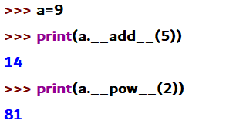
Class customization
Magic Methods for Arithmetic Operators
Operator | Expression | Internally
Addition | p1+p2 | p1. add (p2)
Subtraction | p1-p2 | p1. sub (p2)
Multiplication | p1*p2 | p1. mul (p2)
Power | p1**p2 | p1. pow (p2)
Division | p1/p2 | p1.__truediv _(p2)

Slide 42
Class customization
Simply adding two objects using Binary operator
Example:
class example:
def __init__(self, X):
self.X = X
def __add__(self, U): # adding two objects
return self.X + U.X
object_1 = example( int( input( print ("Please enter the value: "))))
object_2 = example( int( input( print ("Please enter the value: "))))
print (": ", object_1 + object_2)
object_3 = example(str( input( print ("Please enter the value: "))))
object_4 = example(str( input( print ("Please enter the value: "))))
print (": ", object_3 + object_4)
Output:
Please enter the value: 23
Please enter the value: 21 : 44
Please enter the value: Python
Please enter the value: Program
: PythonProgram

Slide 43
Class customization
Overloading operator in another object Adding complex numbers using Binary "+" Operator
class complex_1:
def __init__(self, X, Y):
self.X = X
self.Y = Y
def __add__(self, U): # Now, we will add the two objects
return self.X + U.X, self.Y + U.Y
Object_1 = complex_1(23, 12)
Object_2 = complex_1(21, 22)
Object_3 = Object_1 + Object_2 // Binary "+" Operator
print (Object_3)
Output:
(44, 34)

Slide 44
Class customization
# overload a comparison operators
class A:
def __init__(self, a):
self.a = a
def __gt__(self, other):
if(self.a>other.a):
return True
else:
return False
ob1 = A(2)
ob2 = A(3)
if(ob1>ob2):
print("ob1 is greater than ob2")
else:
print("ob2 is greater than ob1")
Output: ob2 is greater than ob1
class weight:
def __init__(self, weight):
self. weight= weight
def __lt__(self,other):
return self.weight<other.weight
a=weight(50)
b=weight(60)
print(a<b) # TRUE

Slide 45
Class customization
Programming Questions :
Create a Student class and student name passed as a argument and Generate the regno is automatically.
The first object should get regno as 1, second object should get as 2 and so on.
Finally display register number corresponding student name
Example
Input
Arun
Prabu
Output
101 Arun
102 Prabu

Slide 46
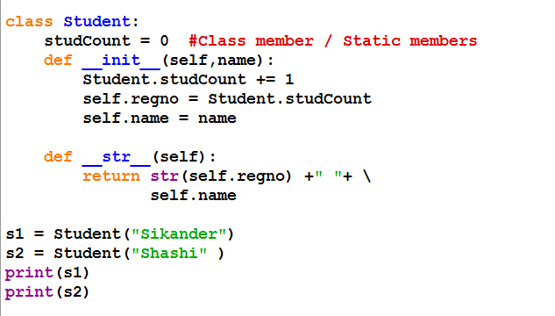

Solution

Slide 47
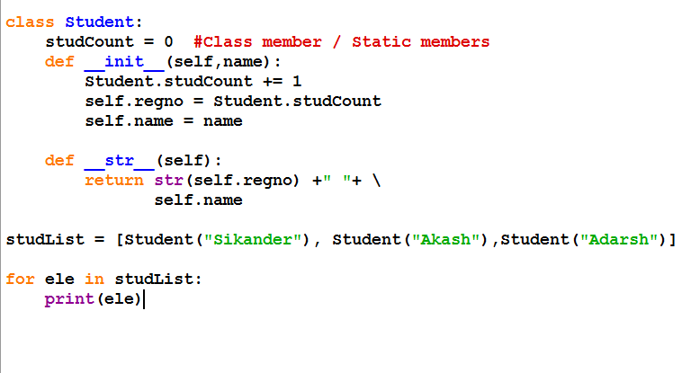
Solution

Slide 48
Memory Allocation
Python’s memory allocation and deallocation method is automatic.
The user does not have to preallocate or deallocate memory similar to using dynamic memory allocation in languages such as C or C++
. Python uses two strategies for memory allocation:
Reference counting
Garbage collection

Slide 49
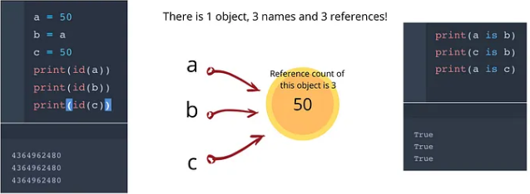
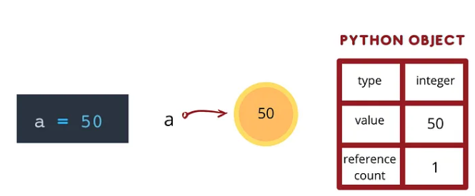
Memory Allocation
Reference counting
Python and various other programming languages employ reference counting, a memory management approach, to automatically manage memory by tracking how many times an object is referenced.
A reference count, or the number of references that point to an object, is a property of each object in the Python language.
When an object’s reference count reaches zero, it becomes un-referenceable and its memory can be freed up

Slide 50
Memory Allocation
Garbage collection
Garbage collection is a memory management technique used in programming languages to automatically reclaim memory that is no longer accessible or in use by the application

Slide 51
Python Decorator
In Decorators, functions are passed as an argument into another function and then called inside the wrapper function.
These are used to modify the behavior of the function.
def func1(msg):
print(msg)
func1("Hii")
func2 = func1
func2("Hii")
In the above program, when we run the code it give the same output for both functions. The func2 referred to function func1 and act as function.
Output:
Hii
Hii

Slide 52
Python Decorator
Decorating functions with parameters
Let's have an example to understand the parameterized decorator function:
def attach_data(func):
func.data = 3
return func
@attach_data
def add (x, y):
return x + y
print(add(2, 3)) # 5
print(add.data) # 3

Slide 53
Generators in Python
Yield Keyword and Iterators There are two terms involved when we discuss generators.
NOTE
The yield statement suspends a function’s execution and sends a value back to the caller, but retains enough state to enable the function to resume where it left off. When the function resumes, it continues execution immediately after the last yield run. This allows its code to produce a series of values over time, rather than computing them at once and sending them back like a list.

Slide 54
Generators in Python
Generator-Function:
A generator-function is defined like a normal function, but whenever it needs to generate a value, it does so with the yield keyword rather than return.
If the body of a def contains yield, the function automatically becomes a generator function.
def simpleGeneratorFun():
yield 1
yield 2
yield 3
for value in simpleGeneratorFun():
print(value)
OUTPUT
1
2
3

Slide 55
Generators in Python
Generator-Object : Generator functions return a generator object. Generator objects are used either by calling the next method on the generator object or using the generator object in a “for in” loop
def simpleGeneratorFun():
yield 1
yield 2
yield 3
x = simpleGeneratorFun()
print(next(x))
print(next(x))
print(next(x))
OUTPUT
1
2
3

Slide 56
Exceptions
Errors – referred as bugs in the program.
Errors occurs maximum by the fault of the programmer.
Debugging – Process of finding and correcting errors.
Two types of errors.:
Syntax errors
Run time errors

Slide 57
Exceptions
When writing a program, we, more often than not, will encounter errors.
Error caused by not following the proper structure (syntax) of the language is called syntax error or parsing error.
Errors can also occur at runtime and these are called exceptions.
They occur, for example, when a file we try to open does not exist (FileNotFoundError), dividing a number by zero (ZeroDivisionError).
Whenever these type of runtime error occur, Python creates an exception object. If not handled properly, it prints a traceback to that error along with some details about why that error occurred.

Slide 58
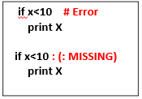
Exceptions
Syntax errors
python interpreter find the syntax error when it executes the coding. Once find the error, it displays the error by stopping the execution.
Common occurring syntax errors are
^{Ø} Putting a keyword at wrong place
^{Ø} Misspelling the keyword
^{Ø} Incorrect indentation
^{Ø} Forgetting symbols like comma, brackets, quotes (“ or ‘)
^{Ø} Empty block

Slide 59
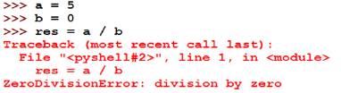
Exceptions
Run time errors
if a program is free of syntax errors then it runs by the interpreter and the errors occurs during the run time of the program due to logical mistake is called runtime errors.
Examples:
^{Ø} Trying to access a file that doesn’t exists
^{Ø} Performing the operations like division by zero
^{Ø} Using an identifier which is not defined

Slide 60
Exceptions
•Definition
– An exception is an event, which occurs during the execution of the program that disrupts the normal flow of the program.
- When the program raises an exception, then python must handle the exception otherwise it terminates and quits

Slide 61
Exceptions
Handling an exception
If you have some suspicious code that may raise an exception, you can defend your program by placing the suspicious code in a try: block.
After the try: block, include an except: statement, followed by a block of code which handles the problem as elegantly as possible.
The try block contains code that might throw an exception.
If that exception occurs, the code in the try block stops being executed, and the code in the except block is executed.
If no error occurs, the code in the except: block doesn't execute.

Slide 62
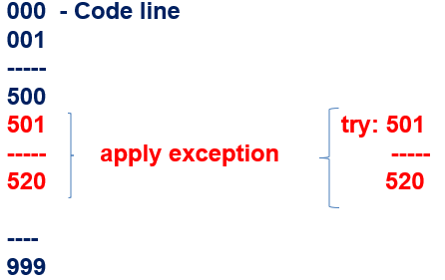
Exceptions
Handling an exception
if we predict suspicious code in our program (line 501 to 520) place that block of code on the try block

Slide 63
Exceptions
Syntax
Here is simple syntax of try....except...else blocks −
try:
You do your operations here;
......................
except Exception - I:
If there is ExceptionI, then execute this block.
except Exception - II:
If there is ExceptionII, then execute this block.
......................
else:
If there is no exception then execute this block.

Slide 64
Exceptions
List of Standard Exceptions − EXCEPTION NAME DESCRIPTION Exception - Base class for all exceptions
ArithmeticError - Base class for all errors that occur for numeric calculation.
ZeroDivisonError - Raised when division or modulo by zero takes place for all numeric types
IOError - Raised when an input/ output operation fails
OverflowError - Raised when a calculation exceeds maximum limit for a numeric type. FloatingPointError - Raised when a floating point calculation fails.

Slide 65
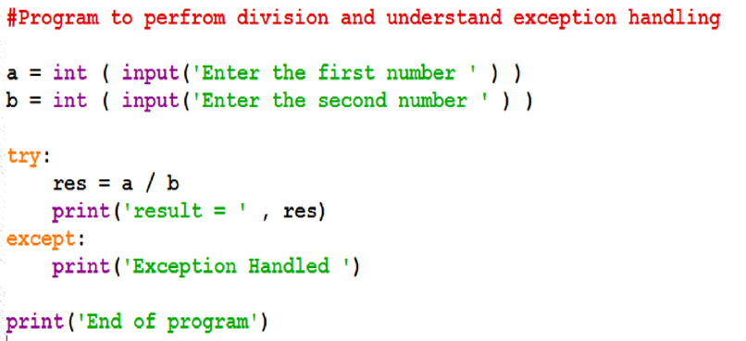
Exceptions
Example
OUTPUT −
2
0
Exception Handled
End of program
OUTPUT −
2
2
End of program

Slide 66
Exceptions
Multiple Exceptions
Use the same except statement to handle multiple exceptions as follows −
try:
You do your operations here;
......................
except(Exception1[, Exception2[,...ExceptionN]]]):
If there is any exception from the given exception list,
then execute this block.
......................
else:
If there is no exception then execute this block.

Slide 67
Exceptions
EXAMPLE –
try:
a = eval(input('Enter a number: '))
print (3/a)
except NameError:
print('Please enter a number.')
except ZeroDivisionError:
print("Can't enter 0.")
OUTPUT −
Enter a number: 3
1.0
OUTPUT −
Enter a number: 0
Can't enter 0
OUTPUT −
Enter a number: a
Please enter a number

Slide 68
Exceptions
Nested Exceptions - Try block with in another try block is called nested try block
EXAMPLE
try:
a = eval(input('Enter a number: '))
try:
print (3/a)
except ZeroDivisionError:
print("Can't enter 0.")
except NameError:
print('Please enter a number.')
OUTPUT −
Enter a number: 3
1.0
OUTPUT −
Enter a number: 0
Can't enter 0
OUTPUT −
Enter a number: a
Please enter a number

Slide 69
Exceptions
The try-finally
To ensure some code runs no matter what errors occur, you can use a finally statement.
The finally statement is placed at the bottom of a try/except statement.
Code within a finally statement always runs after execution of the code in the try, and possibly in the except, blocks.
The syntax of the try-finally statement is this −
try:
# Some Code....
except:
# optional block
# Handling of exception (if required)
else:
# execute if no exception
finally:
# Some code .....(always executed)

Slide 70
Exceptions
EXAMPLE:
try:
a = eval(input('Enter a number: '))
k = 3/a # raises divide by zero exception.
print(k)
except ZeroDivisionError:
print("Can't divide by zero")
finally:
print('This is always executed')
OUTPUT : 1
Enter a number: 3
1.0
This is always executed
OUTPUT : 2
Enter a number: 0
Can't divide by zero
This is always executed

Slide 71
Exceptions
Raising an Exceptions The raising statement in Python is used to forcefully invoke an exception. The general syntax for the raise statement is as follows. Syntax raise [ Exception ]
EXAMPLE
try:
raise " Invalid level! "
print “ Raise exception” # Not executed
# The code below to this would not be executed # if we raise the exception

Slide 72
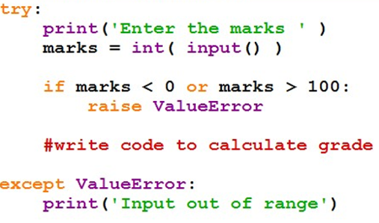
Exceptions
Raising an Exceptions

Slide 73
Exceptions
Exceptions with functions
# Define a function here.
def temp_convert(var):
try:
k = 3/a
print(k)
except :
print("Can't divide by zero\n")
# Call above function here.
a = eval(input('Enter a number: '))
temp_convert(a);
OUTPUT : 1
Enter a number: 3
1.0
OUTPUT : 2
Enter a number: 0
Can't divide by zero

Slide 74
Exceptions
User-Defined Exceptions
- Python also allows you to create your own exceptions by deriving classes from the standard built-in exceptions.
class Networkerror(RuntimeError): def __init__(self, arg): self. args = arg
try: raise Networkerror(" Bad hostname" ) except Networkerror, e: print e. Args
OUTPUT : “Bad hostname “

Slide 75
Exceptions
THANK YOU..
Module – 3 END

